Slide 1


Timber, Boards & the Environment
Understanding Wood Products and Their Ecological Impact
MICLAN FM CONSULTANT • March 2026

Slide 2
What Timber and Boards Are
Timber: processed natural wood used in construction and manufacturing
Boards: plywood, MDF, OSB, particleboard, engineered wood
Widely used in building, furniture, packaging, and design industries

Slide 3
Why Timber Matters Environmentally
Wood stores carbon and reduces atmospheric CO₂
Can be a renewable resource with responsible forest management
Unsustainable logging leads to deforestation and habitat loss

Slide 4
How Timber Is Produced
Trees harvested from forests or plantations
Logs processed into lumber, planks, or veneers
Wood fibres and offcuts used to make engineered boards
Energy use and waste vary by production method

Slide 5
Environmental Impact of Timber Harvesting
Deforestation in poorly managed regions
Loss of biodiversity and wildlife habitats
Soil erosion and increased flood risk
Carbon emissions from machinery and land-use change

Slide 6
Environmental Impact of Board Manufacturing
MDF and particleboard use resins that may release VOCs
High heat and energy required in production
Some boards incorporate recycled wood fibres
Environmental impact depends on adhesives and energy sources

Slide 7
Sustainable Forestry Practices
FSC and PEFC certifications ensure responsible sourcing
Selective logging protects forest structure
Replanting maintains long-term carbon storage
Community forestry supports local livelihoods

Slide 8
Sustainable Timber & Board Alternatives
Reclaimed wood reduces demand for new logging
Bamboo grows rapidly and stores carbon efficiently
Cross-laminated timber (CLT) offers strong, low-carbon building options
Boards made from agricultural waste fibres (hemp, straw, bagasse)

Slide 9
Innovations in Wood Products
Low-VOC and formaldehyde-free adhesives
Bio-based resins replacing petrochemical binders
Engineered wood with strength comparable to steel
Carbon-negative materials using wood waste

Slide 10
Timber in Sustainable Construction
Timber buildings have lower embodied carbon than concrete or steel
Prefabricated timber reduces waste and speeds construction
CLT and glulam enable tall, strong, sustainable structures

Slide 11
End-of-Life & Recycling
Timber can be reused, repurposed, or recycled
Waste wood can be converted to biomass energy (with emissions considerations)
Circular design reduces landfill waste and resource extraction

Slide 12
Call to Action
Choose certified sustainable timber
Support recycled and reclaimed wood products
Encourage responsible forestry and sourcing
Promote timber as a low-carbon building material

Slide 13
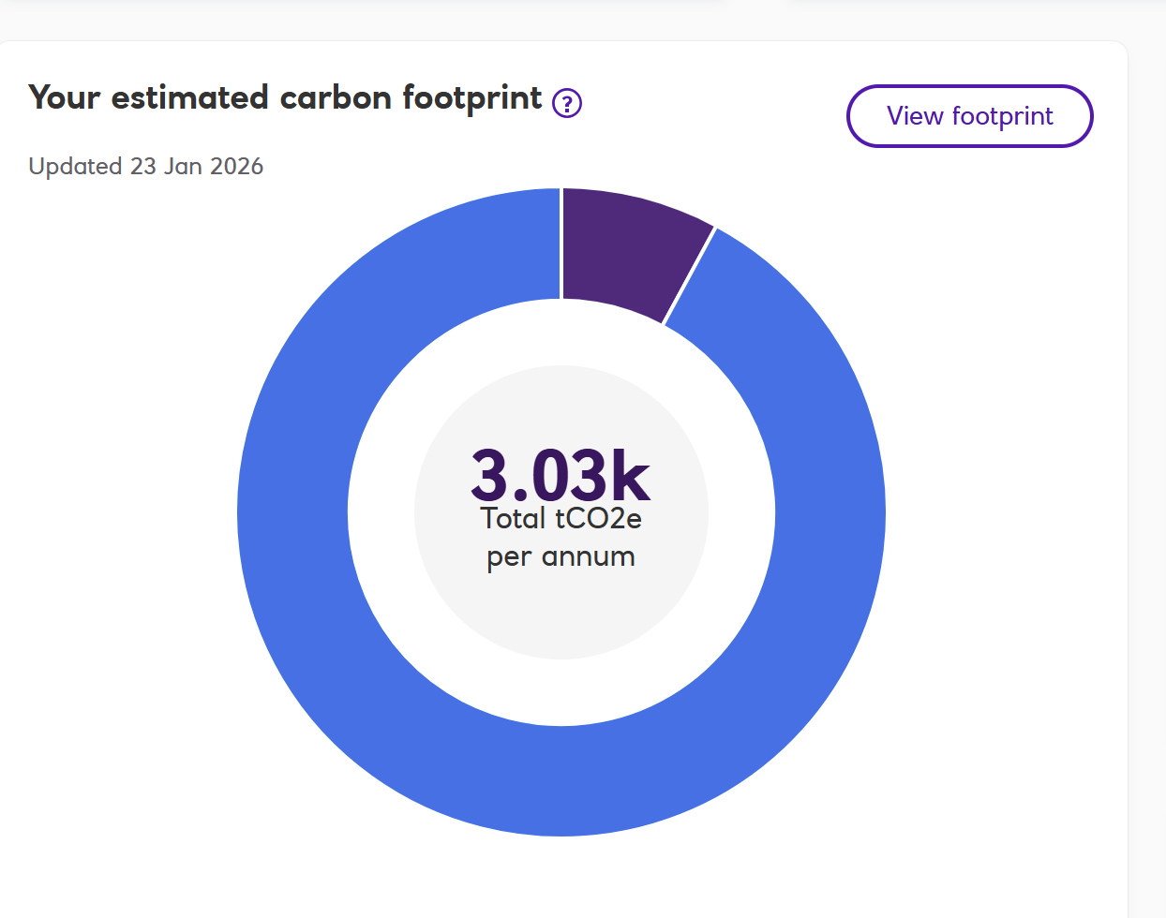
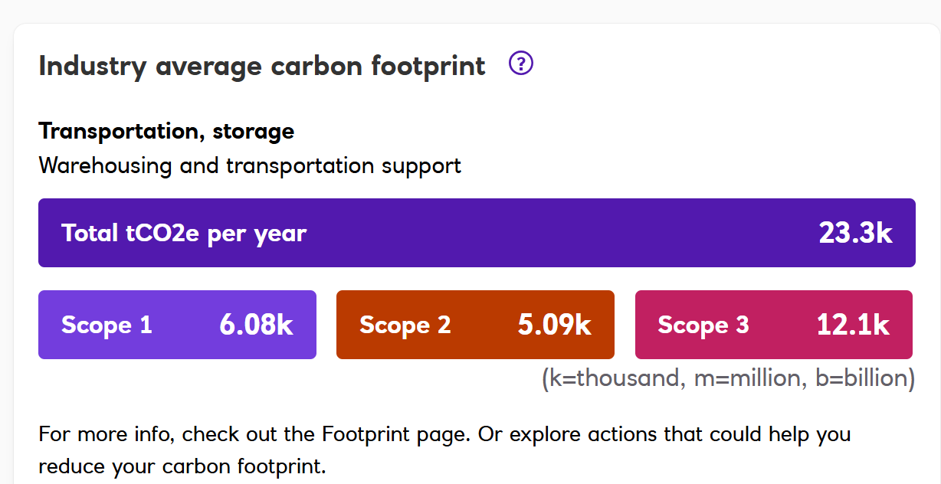
How we Compare

Slide 14
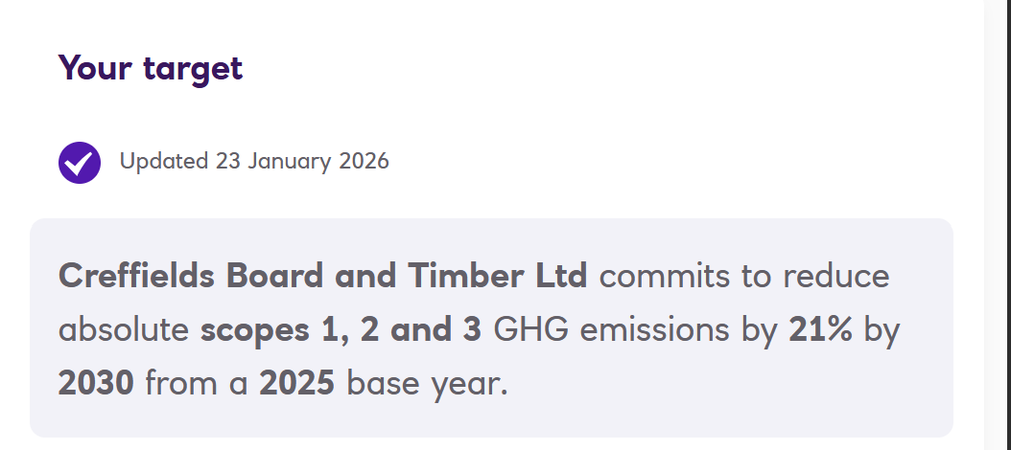
Call to Action

Slide 15
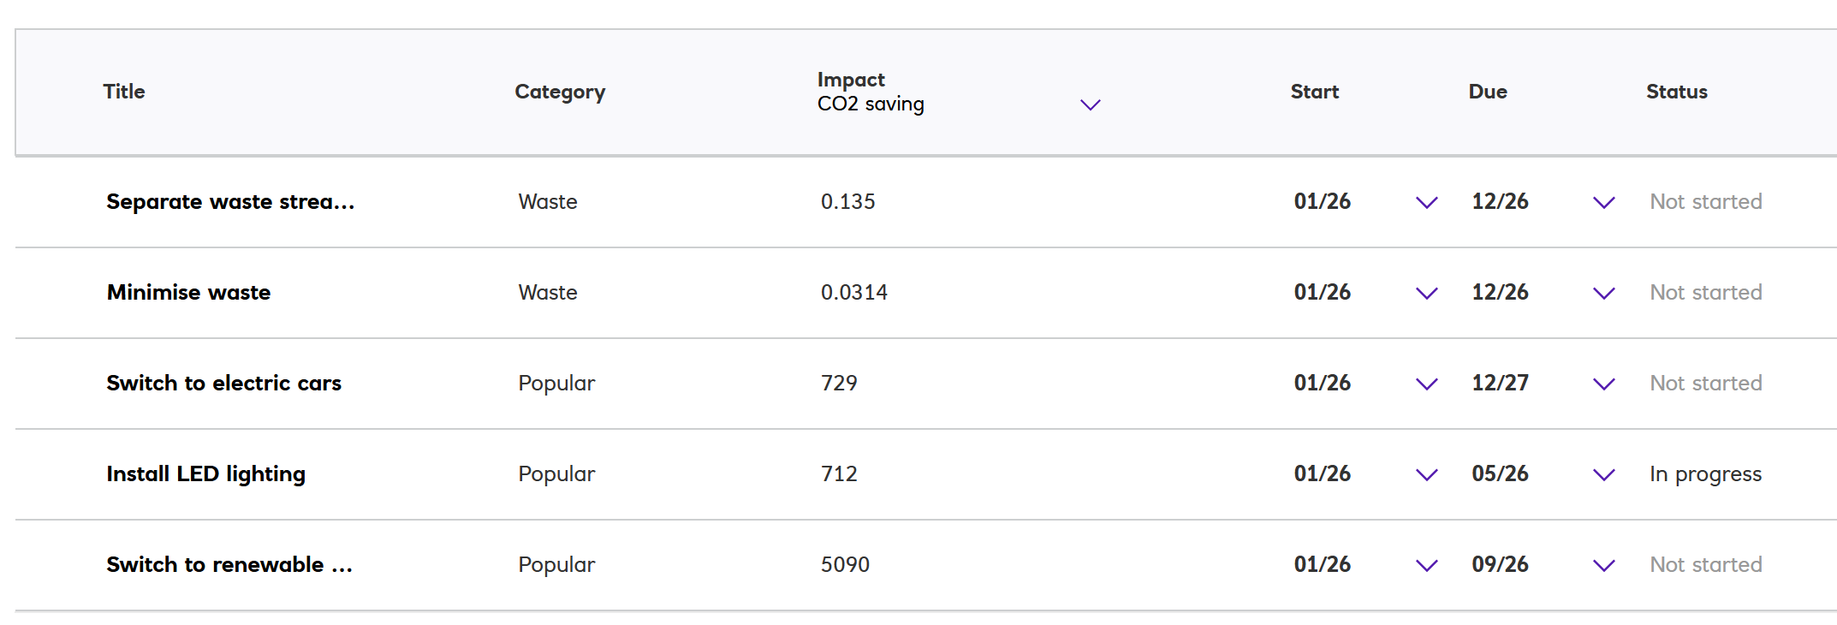
Planned Actions

